Slide 1
KEYLOGGER TYPE OF SOFTWARE
KEYLOGGER PROJECT
Presented By : GEETHA.A
College name : The Kavery Engineering College
Department : Computer science and engineering

Slide 2
OUTLINE
Problem Statement
Proposed System/Solution
System Development Approach
Algorithm & Deployment
Result
Conclusion
Future Scope
References

Slide 3
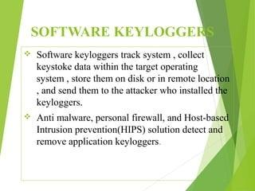

Slide 4
Problem Statement
The problem statement is that the keyloggers can be detected using antiviruses. Installation of hardware keyloggers is difficult without the knowledge of the owner of the system. The solution to the above existing problem is that we can build a software keyloggers instead of hardware keyloggers.

Slide 5
Proposed Solution
The solution to the above existing problem is that we can build a software keyloggers instead of hardware keyloggers. The proposed model provides the solution that reduces the difficulties while installing the keylogger in the target system. Since, software keylogger can be installed remotely and does not need any physical access of the target system. Proposed software is efficient enough to get installed in targeted system by itself when the user for example clicks the malicious link sent to him through mail or any social media and finally captures all the keystrokes of the user while he is logged into the system, saves the logs in a folder or sends the log directly to the mail address of the third party.

Slide 6
System Approach
A keylogger can be installed on your computer any number of ways. Anyone with access to your computer could install it; keyloggers could come as a component part of a virus or from any application installation, despite how deceptively innocent it may look. Some additional ways in which keyloggers can be installed on your computer can include:
Malware downloads:
Phishing emails:
USB drives
Remote access tools:
Hardware Requirements:
1. Pentium Class or higher Processor 2. Minimum 64 MB RAM 3. 20 MB Free Disk Space
Software Requirements:
1. Windows XP/Vista/7/8/10 2. Python IDE

Slide 7
Algorithm & Deployment
Deployment
a. The program will wait for all the system processes to initialize.
b. The keylogger daemon is initialized and the process will be gauged in scale of
Time.
c. A log file is created for the current session to log all the keystrokes and maintain a record.
d. If no event occurs, keylogger continues listening to the strokes.
e. If an event occurs, the keylogger classifies the type of keystroke that has occurred- special key which are commands or normal text input.
f. If a special key that gives a command has been entered then it is compared with a value in a dictionary and recorded in the log file.
g. If a normal text i.e. anything in the range of ASCII characters has been inputted, the ASCII code is converted to its respective character and this is exported to the log file.
h. The inputs along with their timestamps are recorded in the log file.

Slide 8
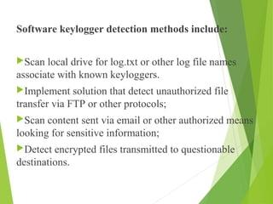

Slide 9
Result
Keyloggers span a wide range of topics, including keylogger design and implementation, legal and ethical issues, real coding, and current activity in this field. These projects are especially encouraging because they give students a hands-on exposure to software security programmers. Keyloggers are an important part of today's cybersecurity education.

Slide 10
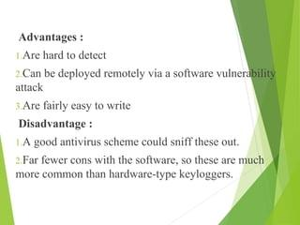

Slide 11
Conclusion
Keyloggers are sophisticated tools that can access not only the platform, but also the user's private information like their name, password, pin, card and bank statement. While some keyloggers are utilized in a legal manner, the creators of many keyloggers do so unlawfully. The most frequent keylogger types and strategies used to hide themselves while subverting a user's PC were examined in this study. In addition, we looked at the present situation of keyloggers and the methods through which they spread Finally, we looked into existing detection methods and made some recommendations for prevention.

Slide 12
Future scope
Monitoring keylogging technology within an organization is similar to controlling other dangerous code or threats is that Universal awareness, regular monitoring, and layered protection are all required. The most essential thing is to be aware of the implications, to understand how it works, and to know how to identify it. As a consequence, malware detection and countermeasures must be part of the emergency response plan for the firm

Slide 13
References
Use of legal software products for computer monitoring, keylogger.org.
V. W. Berninger (Ed., 2012), Past, present, and future contributions of cognitive writing research to cognitive psychology. New York/Sussex: Taylor & Francis. ISBN 9781848729636.
John Leyden (2000-12-06). "Mafia trial to test FBI spying tactics: Keystroke logging used to spy on mob suspect using PGP". The Register. Retrieved 2009-04-19.
Andrew Kelly (2010-09-10). "Cracking Passwords using Keyboard Acoustics and Language Modeling". 5 Sarah Young (14 September 2005). "Researchers recover typed text using audio recording of keystrokes". UC Berkeley NewsCenter

Slide 14
THANK YOU

